Slide 1


ABAP on Hana s/4 Hana Training
Day 9
contact@anubhavtrainings.com

Slide 2

Agenda – Day 9
Describing Data Objects in SQL Script ( Variables )
Concept of Procedure
Create Procedure
Update Procedure
Delete Procedure
Concept of Cursor
Making Procedure with parameters
Making Anonymous Block in HANA Database
Reuse Function for SQL queries

Slide 3
Data Objects in SQL Script ( Variables )
2
Array
List of values of single data type
DECLARE arr datatype ARRAY;
3
1
Scaler
Table Type
Used to store single value
Syntax:
DECLARE varname vtype;
Numbers – INT, BIGINT, TINYINT, DECIMAL
Char – VARCHAR, NVARCHAR, CHAR, STRING
Date – DATE, TIMESTAMP
Other – BLOB, CLOB.
2 type of Table types
Implicit
Explicit
Data Variables

Slide 4
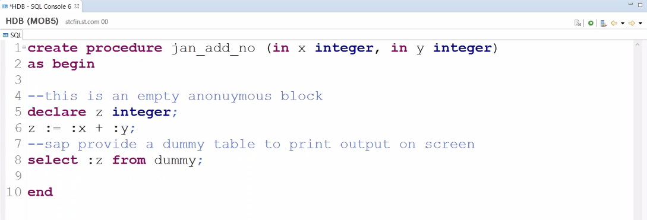
Concept of Procedure
A procedure is a unit/module that perform a specific task. This procedure can be combined to form larger programs. This basically forms the 'Modular Design'. A procedure can be invoked by another procedure which is called the calling program.
Procedures are re-useable processing block with a specific sequence of data transformation. The procedure can have multi-input/output parameters. The procedure can be created as read-only or read-write.

Slide 5
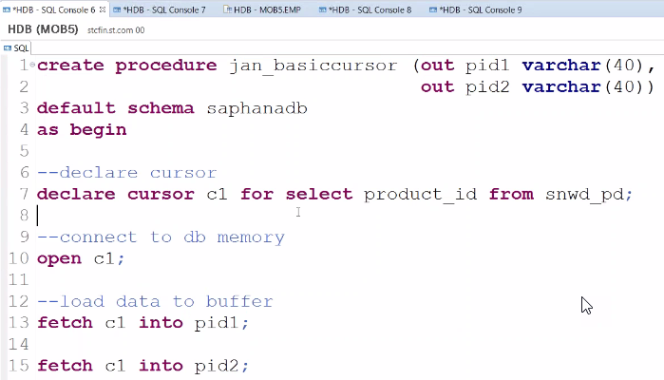
Cursor
Cursor is used to fetch single rows from the result set returned by a query. Cursors can be defined either after the signature of the procedure and before the procedure's body or at the beginning of a block with the DECLARE token. The cursor provides the functionality to iterate through a query result row-by-row.
You can name a cursor so that it could be referred to in a program to fetch and process the rows returned by the SQL statement, one at a time.
There are two types of cursors −
Implicit cursors
Explicit cursors
A cursor is assigned to a query. We can traverse over record by record.
Steps:
Declare
Open
Fetch
Close

Slide 6

Exercise
SQL Script Advance

Slide 7
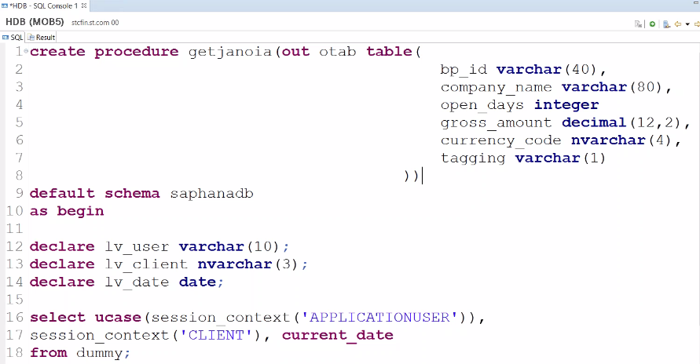
Anonymous Block in HANA
An anonymous block is an executable DML statement which can contain imperative or declarative statements and is
defined and executed in a single step.
All SQLScript statements, supported in procedures, are also supported in anonymous blocks.

Slide 8


Exercise
OIA Using SQL Script Advance

Slide 9

End of Day 9
Trainer: Anubhav Oberoy & Shubham Singh

Slide 10

Trainer: Anubhav Oberoy & Shubham Singh

Slide 11
THANK YOU
If you cannot do
great things, do small things in a great way.
Anubhav Oberoy
https://www.anubhavtrainings.com

Slide 12


We’re committed to empower you to be
Most Desirable Resource
through powerful training solutions.
We build the workforce of the future.
250+
Corporate Clients
30,000+
Learners Trained
25000+
Learners Placed
FREE WEBINARS
Sign up for free webinars with industry experts every fortnight!
Enroll Now!
Contact us today!
https://anubhavtrainings.com/

Slide 13




More from AnubhavTrainings.com

